Slide 1
Personalised Game Application for aiding Primary School Students with Math Learning
Student: Saira Javed Barlas
Student Number: C12809080
Supervisor: Dr. Pierpaolo Dondio

Slide 2
What will be covered
Objectives and Features
Brief overview of research conducted
Architectural Diagram
Technologies Implemented/Utilised
Methodology
Plan
Major Differences
Achieved and the Future
Demo

Slide 3
Objectives and Features
Develop an Android Application for Primary School Students
Between 8 – 12 years of age
Various categories and quiz like game approach
10 Questions in each category
Graph view showing %INCORRECT and %CORRECT answers
Result View shows the correct and student answers
Android Material Design with various libraries and a database

Slide 4
Research Conducted
Students
Games and the Student Brain
Teaching a Student
The Seven Learning Styles
Principles for User Interface Design
Jakob Nielsen and Rolf Molich
Android Design Principles
Alternative Existing Solutions
Kahoot
Math Puzzle – Brain Trainer

Slide 5
Research Conducted
Technologies
Android/Android Studio
Java
XML
Git
SDP
CircleView
Material Design
SQLite Database and SQLiteAssetOpenHelper
DB Browser for SQLite
Other Relevant Research
Pixabay
Cooltext
Colour Scheme

Slide 6
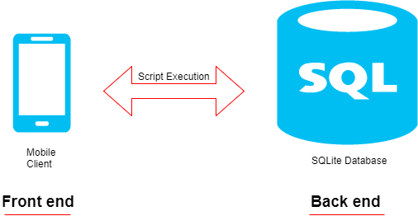
Architectural Diagram
2 tier architecture

Slide 7
Technologies Implemented/Utilised
Android/Android Studio
Java
XML
Git
SDP
CircleView
Material Design
SQLite Database and SQLiteAssetOpenHelper
DB Browser for SQLite

Slide 8
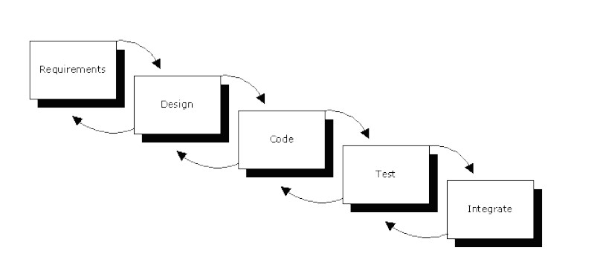
Methodology
RAP Waterfall Methodology

Slide 9
Plan
Oct – project proposal, discussion with math teacher
Nov – functionality and end user requirements, mock ups, use cases
Dec – interim report, presentation, feedback
Jan – technologies finalised and implementation started
Feb + Mar – implementing and fixing bugs
Apr – submission
June + July – More research, User Interface, fixing features, fixing bugs
Aug – Black Box Testing, User Testing, final feedback, submission

Slide 10
Major Differences
More Research; students, learning, design principles, user interface, assets, technological libraries
Use of SQLite database and SQLiteAssetOpenHelper
Implementation of a Visual Graph and View Results
Testing; Black Box, User
Report

Slide 11
Achieved and the Future
Game development, handling a project/software
Testing; Feedback and Time Management
Communication
Technical skills; implementation and logic
Android and Research
How students learn and teachers teach
Myself!
Future? Fixing one teeny bug in Result View

Slide 12
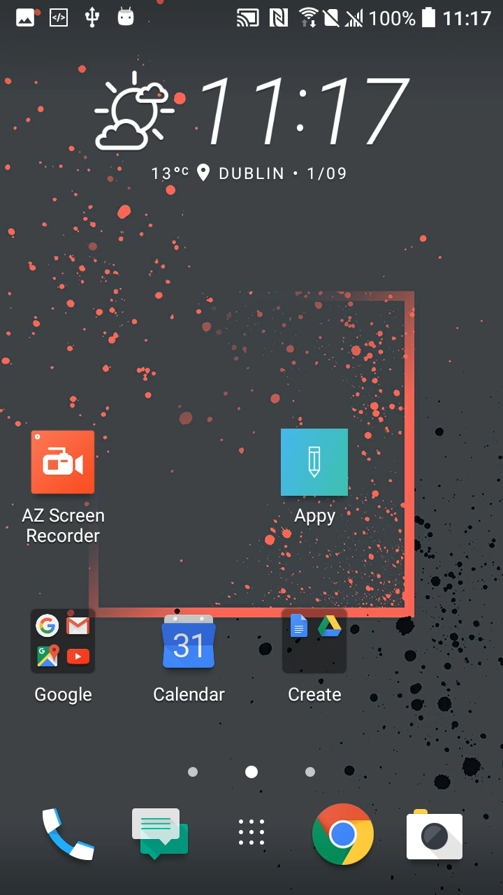
Demo

Slide 13

Thanks!

